Slide 1
How to create a corpus of machine-readable texts:
challenges and solutions

Slide 2
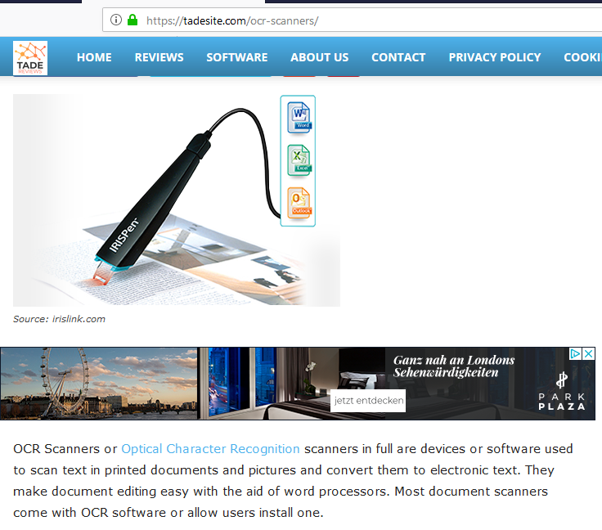
What is OCR and how does it work?
Definition of OCR according to the Oxford Dictionary of Computer Science, p. 379: „OCR = optical character recognition; a process in which a machine scans, recognizes, and encodes information printed or typed in alphanumerical characters. (…) OCR software is now readily available for many low-cost scanners giving good recognition rates for printed material using the Latin alphabet. The more difficult problems posed by other character sets and handwriting are areas of ongoing research.“

Slide 3
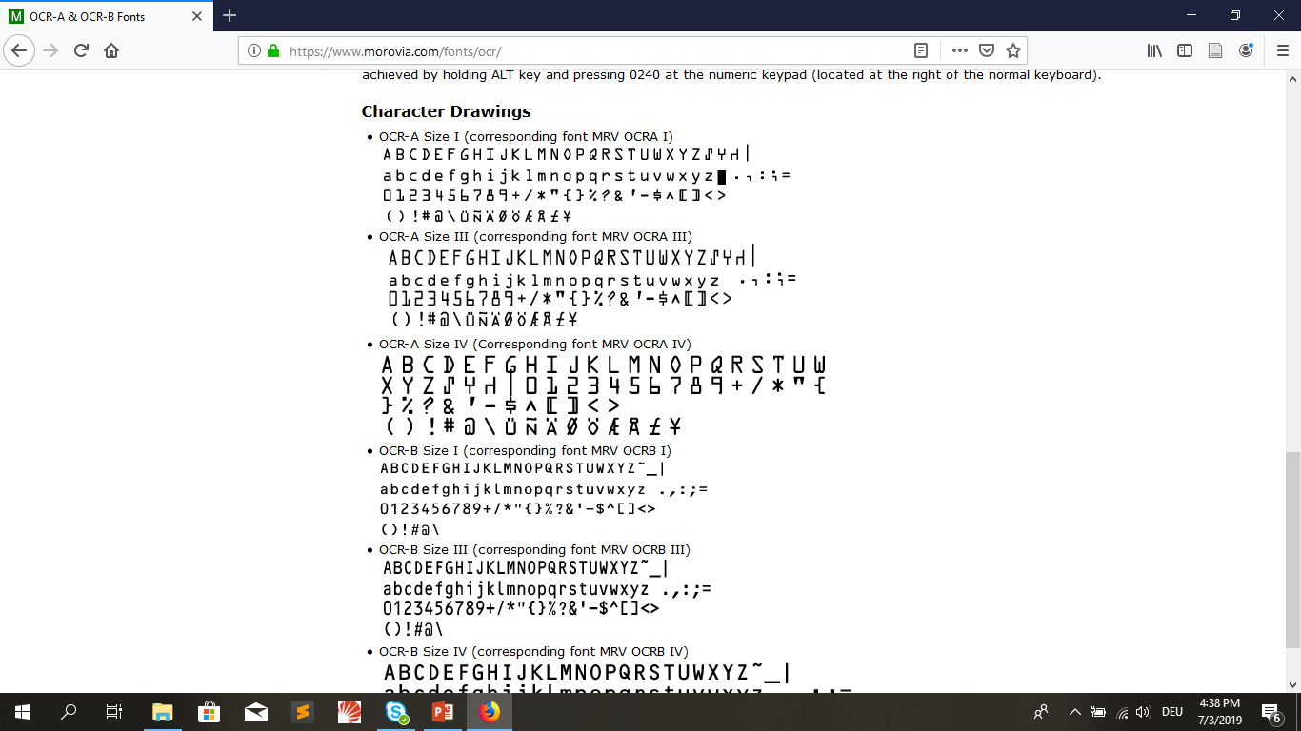
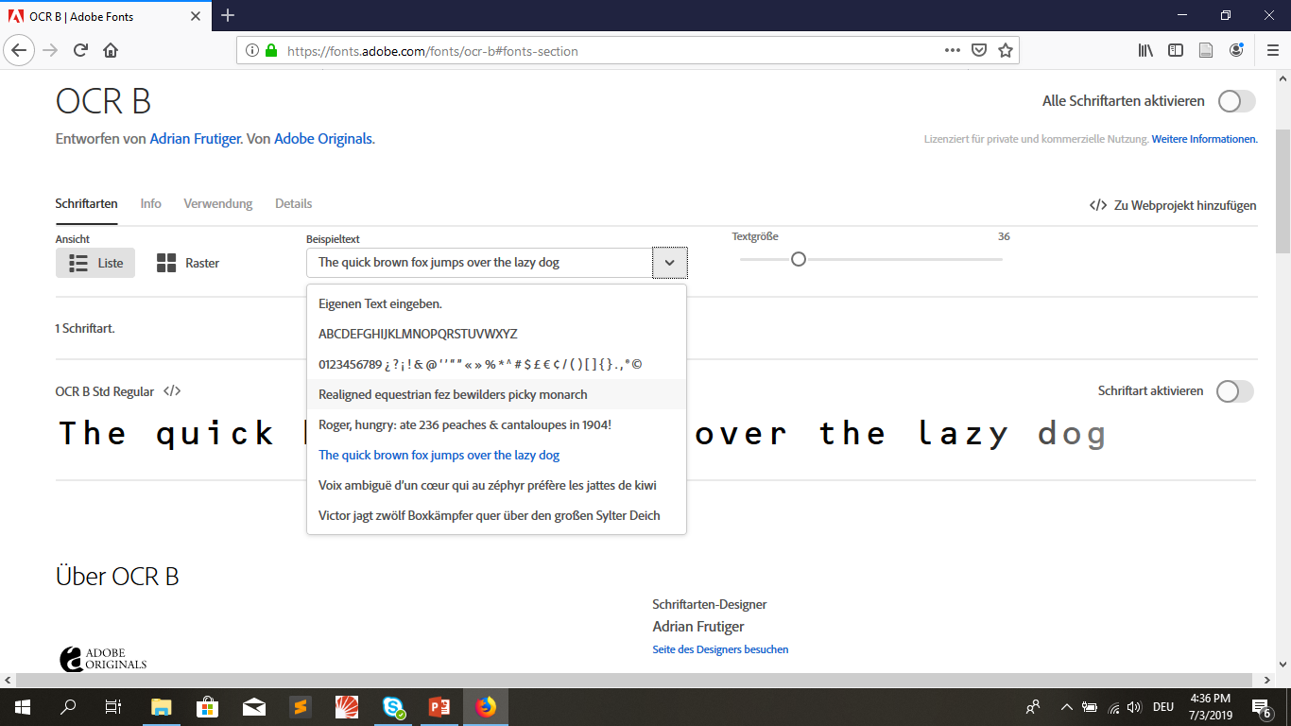
When was OCR software invented?
mid-1970s: OCR A font and OCR B font (similar to normal letter-press appearance)
Ca. 1955: early OCR devices only recognised limited set of characters in machine-optimised font

Slide 4

Do we encounter OCR in everyday-life?
High accuracy rates have popularised OCR in the following areas:
banking (machines „reading“ paper cheques and transfer forms)
public administration
health-care (e.g. machine-readable precriptions)
NOTE: In cases where absolute perfection is needed, OCR A and OCR B fonts are still used.
If sensitive information is handled, OCR technology can be combined with the so-called MICR technology (magnetic-ink character recognition) checking the legitimacy or originality of paper documents.

Slide 5
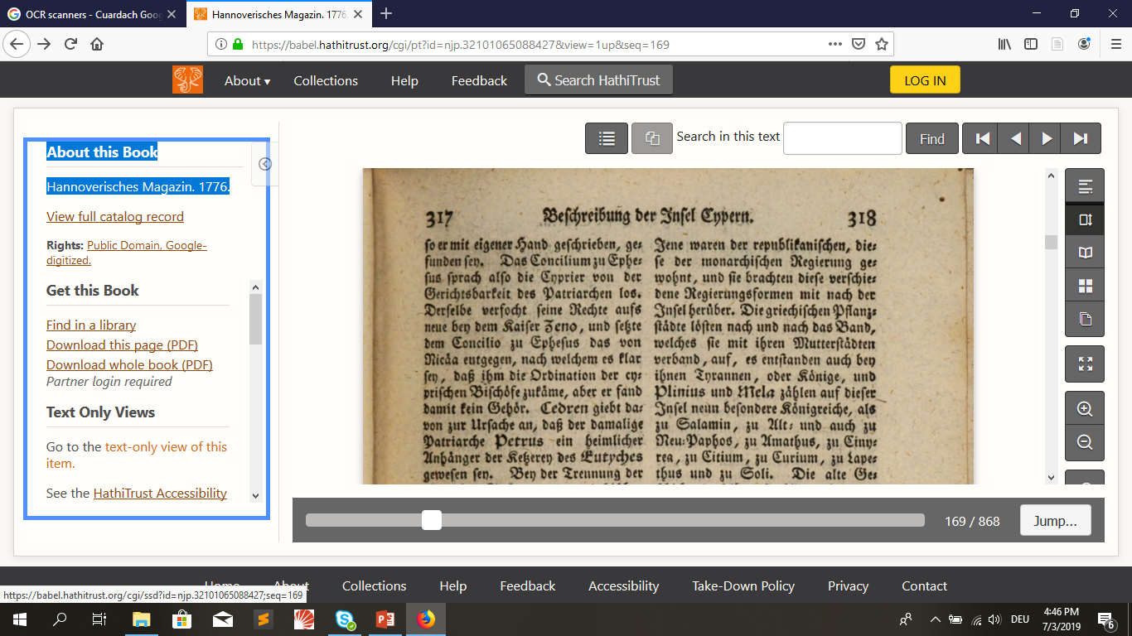
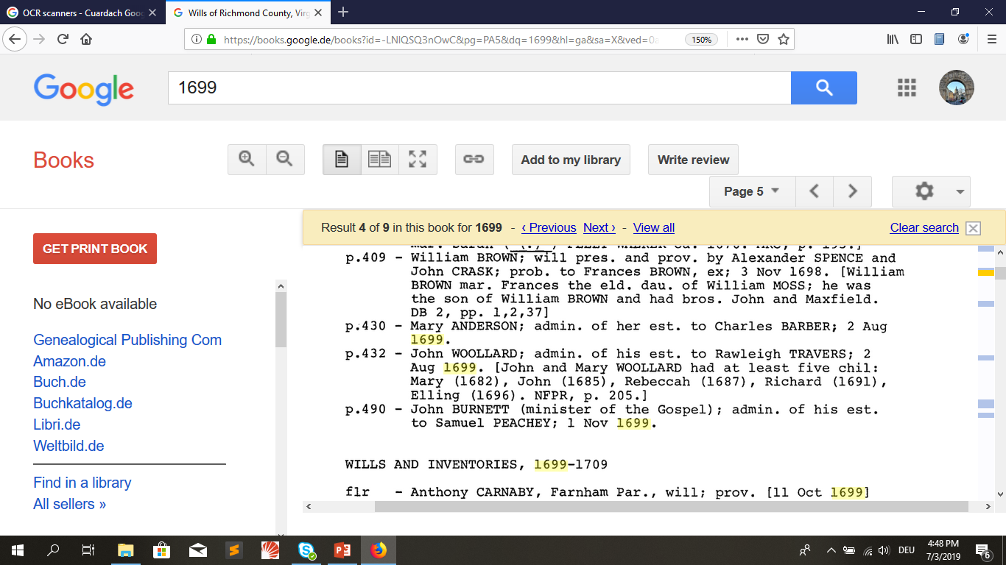
Are humanities tools using OCR?
Google Books: full-text search + highlighting of text results
HathiTrust full-text view

Slide 6
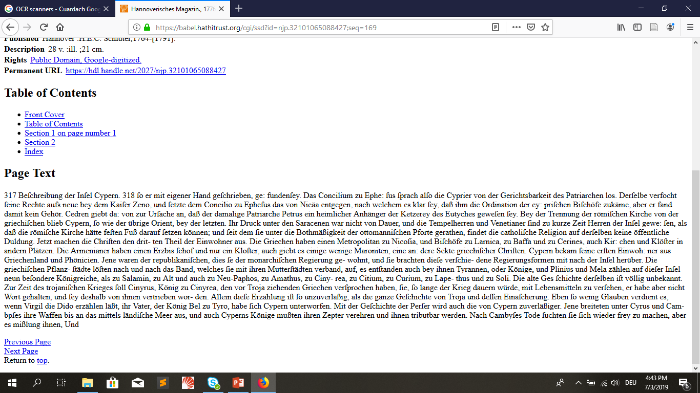

What are ORC problems in historical research?
„Hannoverisches Magazin”, 1776

Slide 7
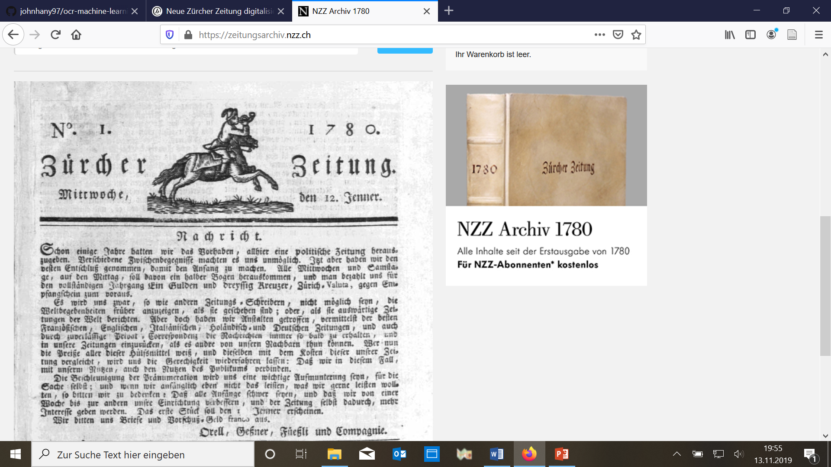
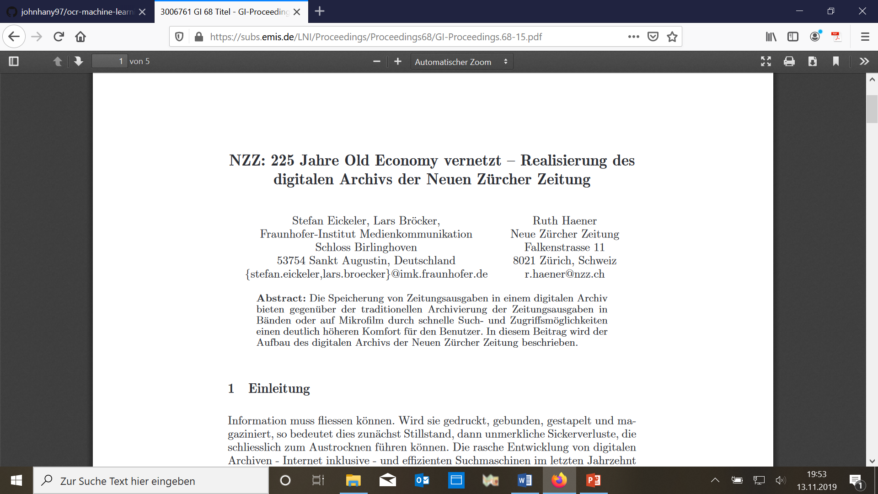
Best historical OCR results: texts in standardised formats (e.g. periodicals)

Slide 8
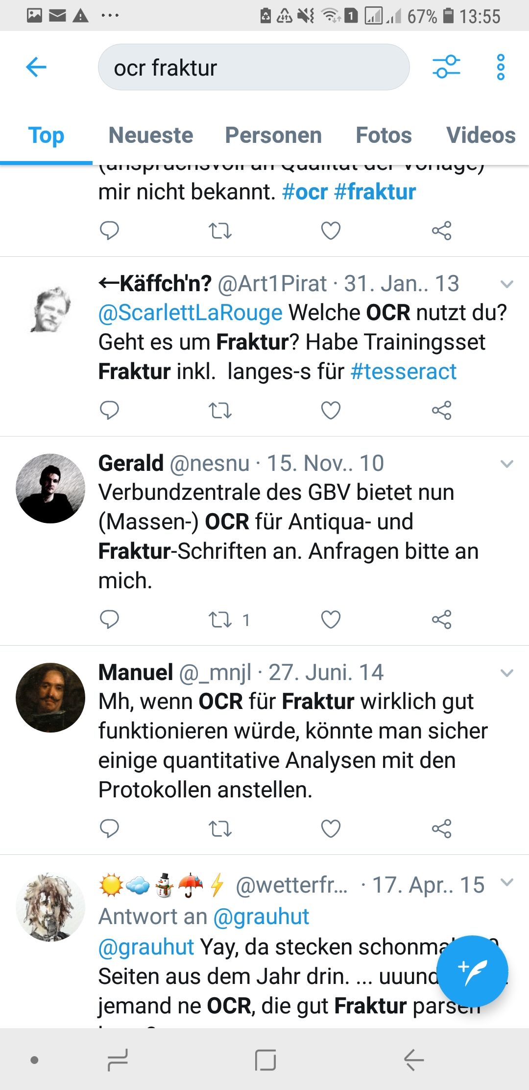
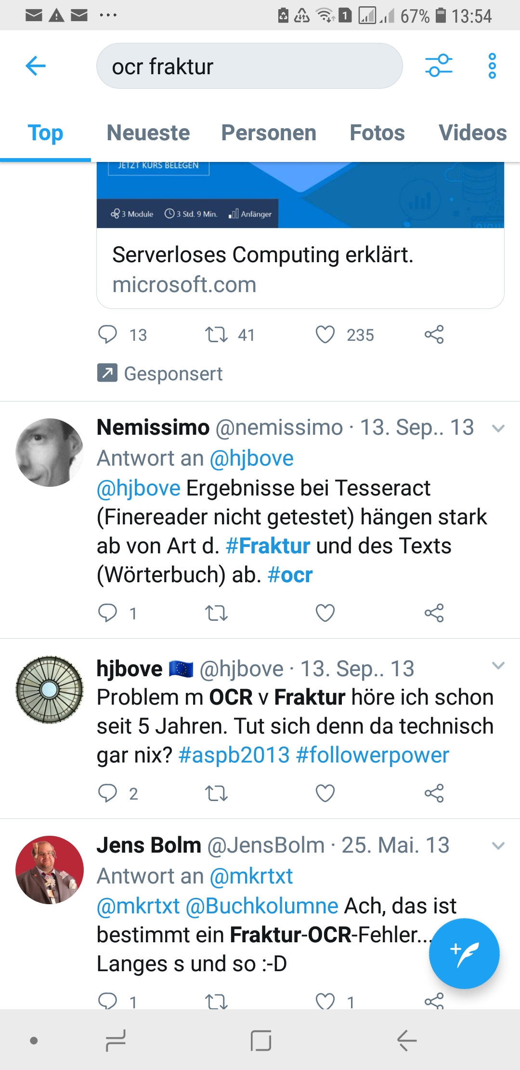
Improving results for minority languages and old fonts – an on-going challenge

Slide 9
Recent innovation: merging OCR and handwriting recognition technologies (HWR/HTR)
“Handwriting recognition (HWR), also known as Handwritten Text Recognition (HTR), is the ability of a computer to receive and interpret intelligible handwritten input from sources such as paper documents, photographs, touch-screens and other devices. The image of the written text may be sensed "off line" from a piece of paper by optical scanning (optical character recognition) or intelligent word recognition. Alternatively, the movements of the pen tip may be sensed "on line", for example by a pen-based computer screen surface, a generally easier task as there are more clues available. A handwriting recognition system handles formatting, performs correct segmentation into characters, and finds the most plausible words.” Wikipedia.org

Slide 10
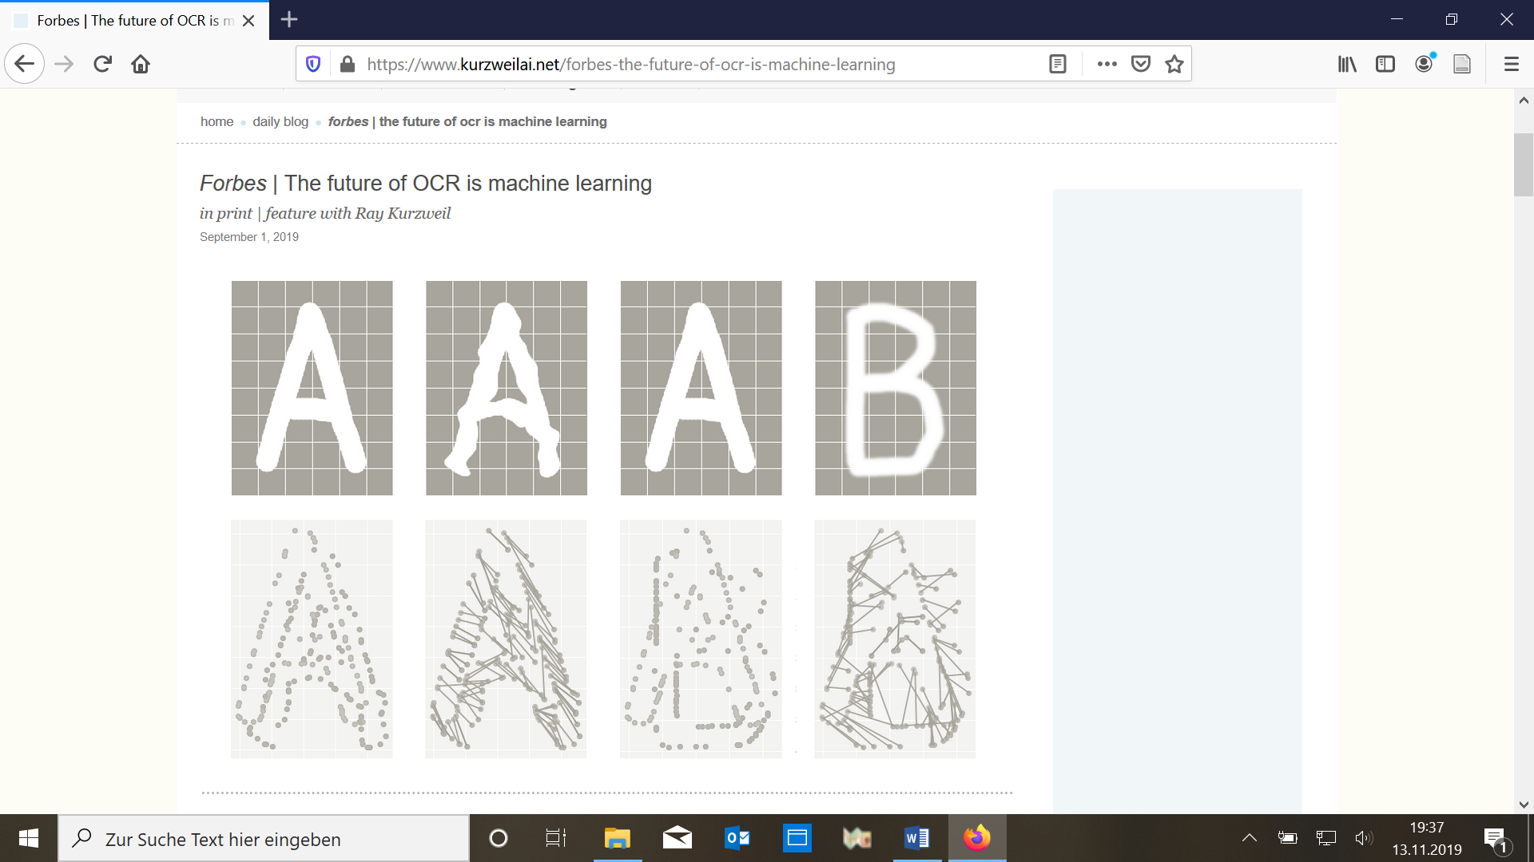
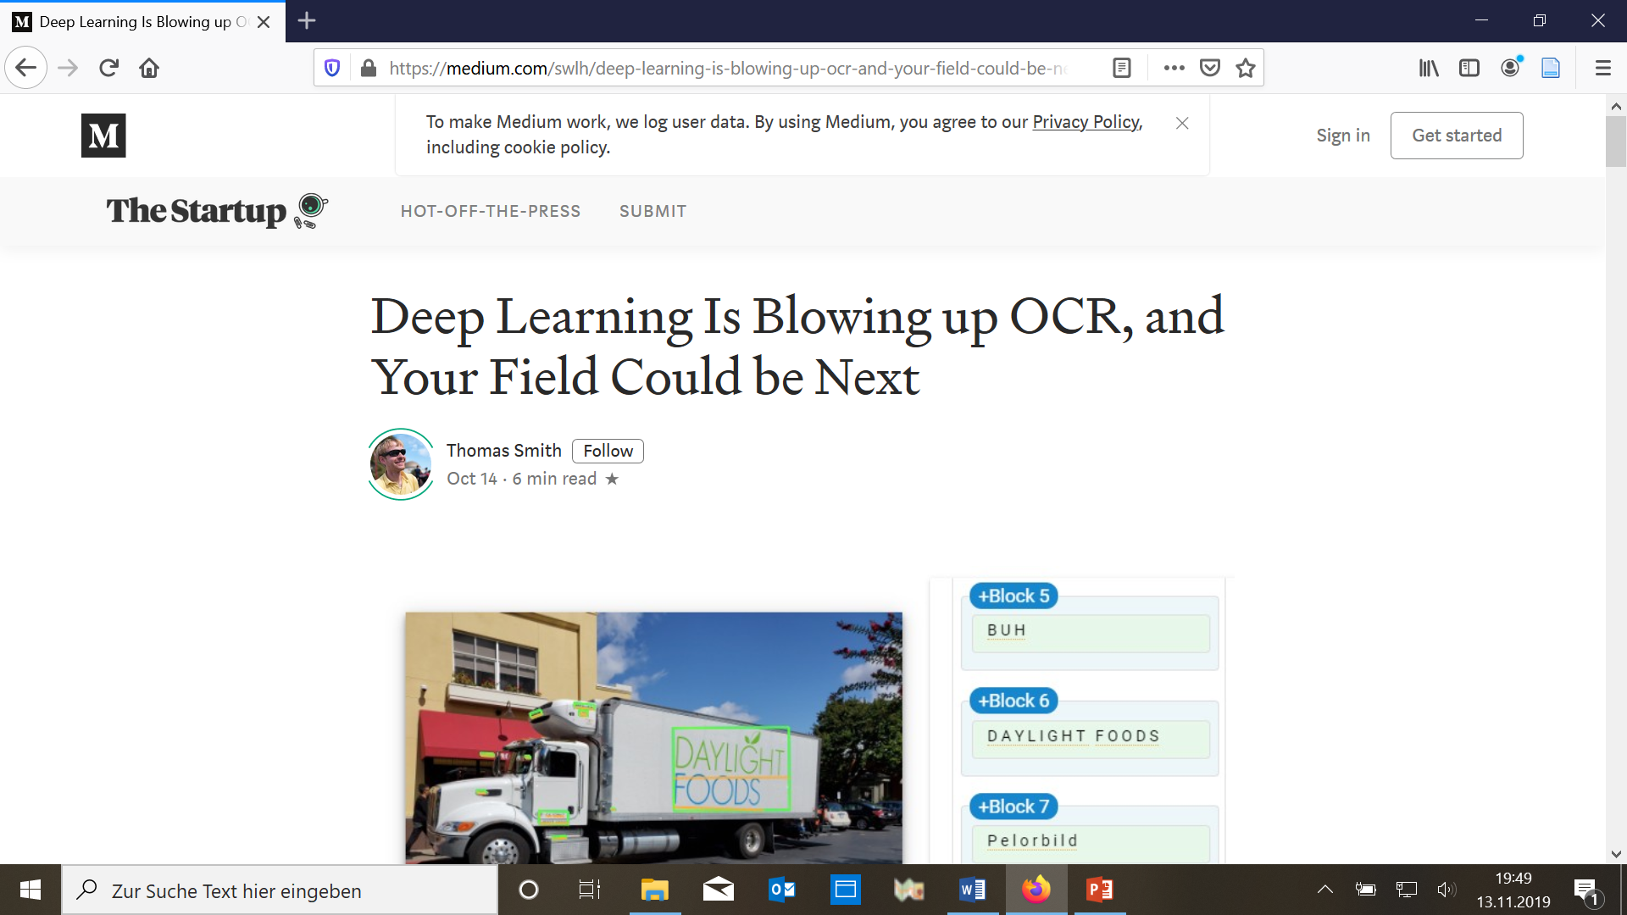
The machine learning revolution in OCR

Slide 11
How does machine learning work?
Cf. Stanford OCR pipeline:
text detection (layout recognition)
character segmentation (using „sliding window“ technique)
character classification
spell correction
(http://doremi2016.logdown.com/posts/2017/01/20/standford-machine-learning-photo-ocr-machine-learning-pipeline)
This is an example of a sliding window for character recognition…..

Slide 12
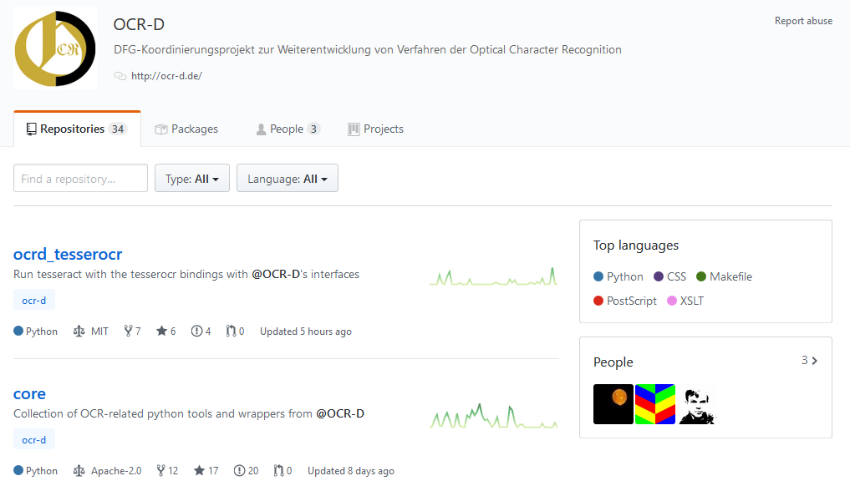
New OCR tools based on machine learning
E.g. OCR-D project in Germany:
improved visual character recognition
context analysis of n-grams
trainer feedback to exclude potential mistakes

Slide 13
Current range of OCR-tools for researchers
Transkribus.eu (free of charge, cloud-based, each user contributes training data to the community)
OCR4all (free command-line OCR software for desktop-installation, difficult set-up, does not run smoothly on Windows)
KRAKEN (Python package for OCR, usage not monitored, data do not need to be shared with developers or others users)
ABBYY FineReader (one of the most popular proprietary OCR tools)
Tesseract (originally developed as proprietary software at Hewlett Packard labs in England and the US, released as open source in 2005, supported by Google since 2006, available for Linux as well as Windows and Mac OS X, high pre-processing requirements)
PICCL/TICCL (free corpus building and corpus clean-up system performing spelling correction and OCR post-correction, developed for LINUX, requires virtual machine on Windows)

Slide 14
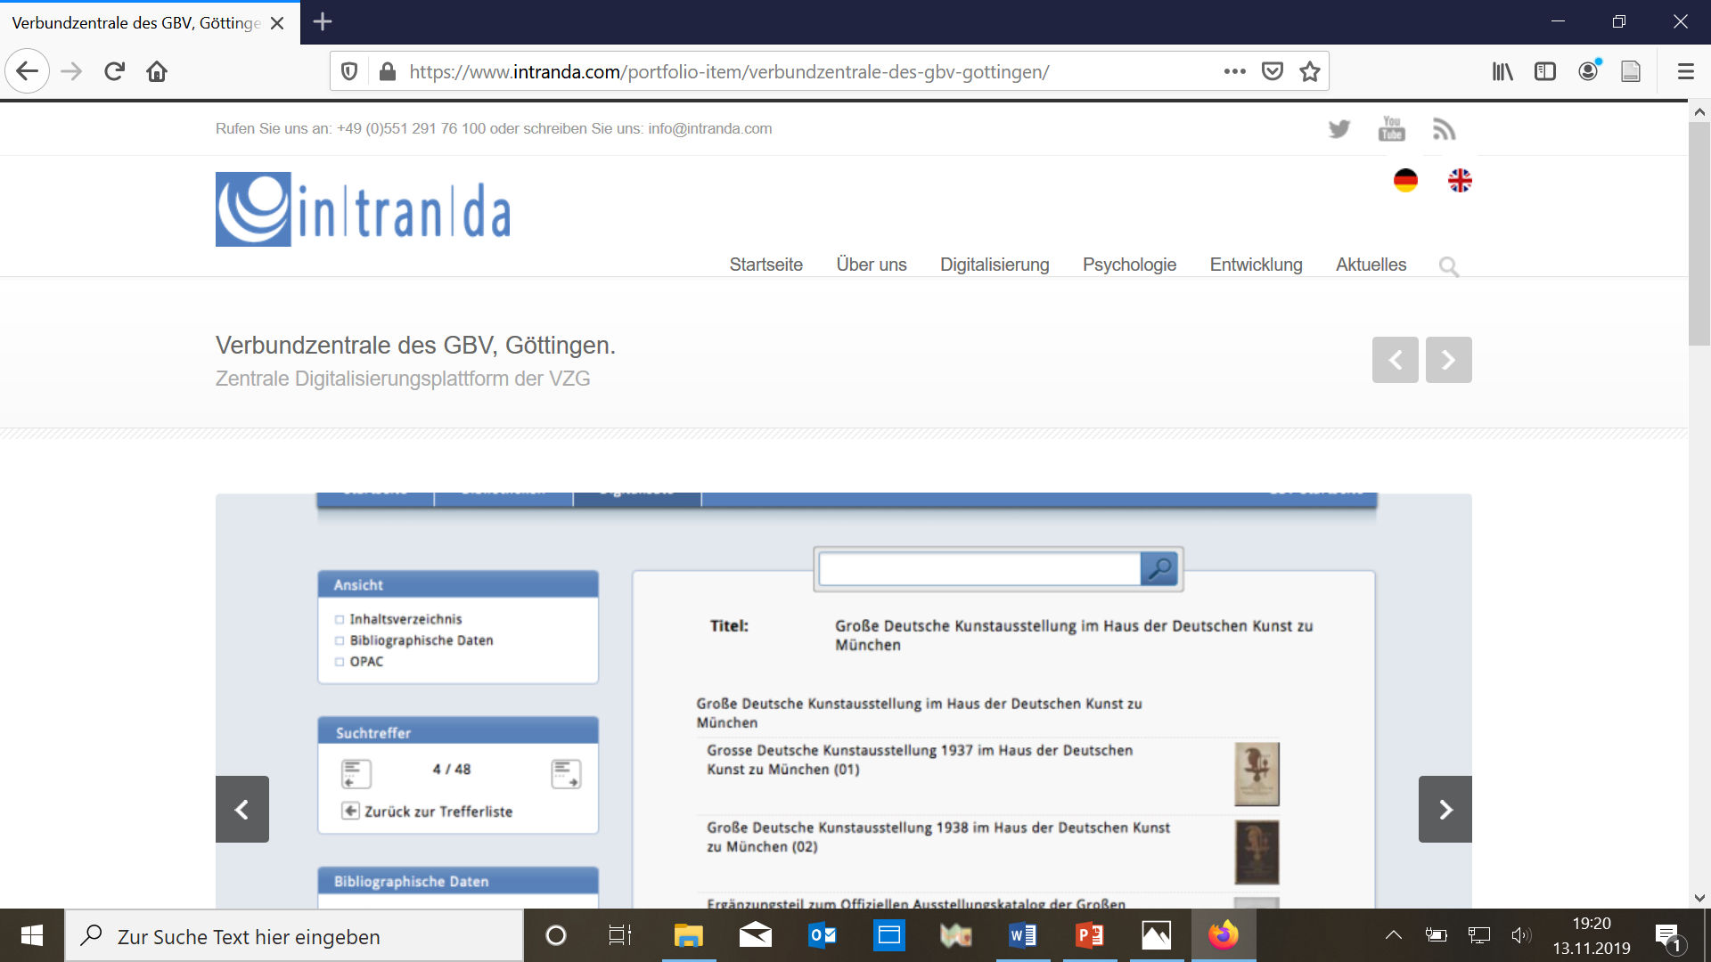
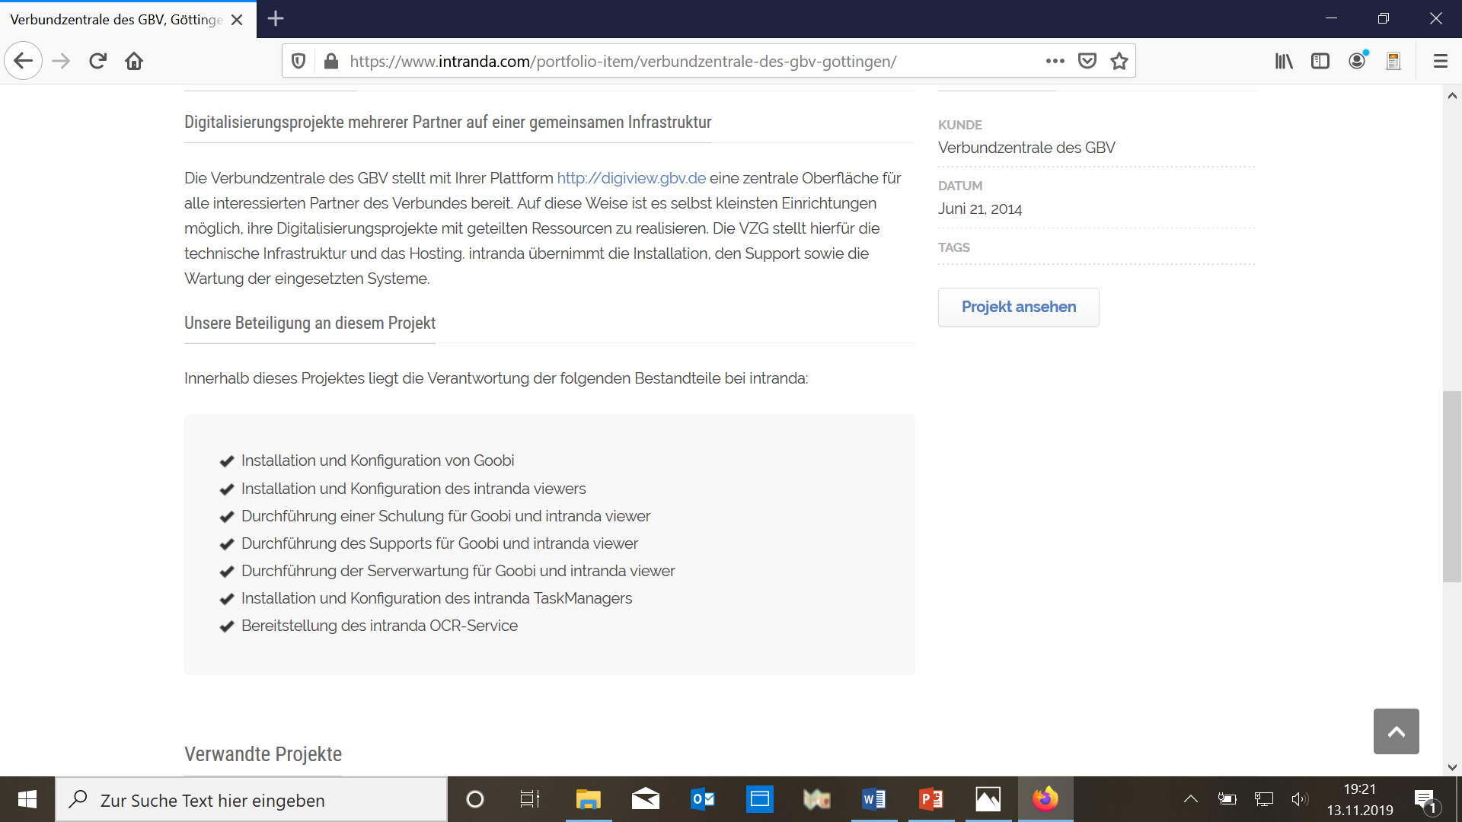
GBV-Verbund: Intranda OCR Service

Slide 15
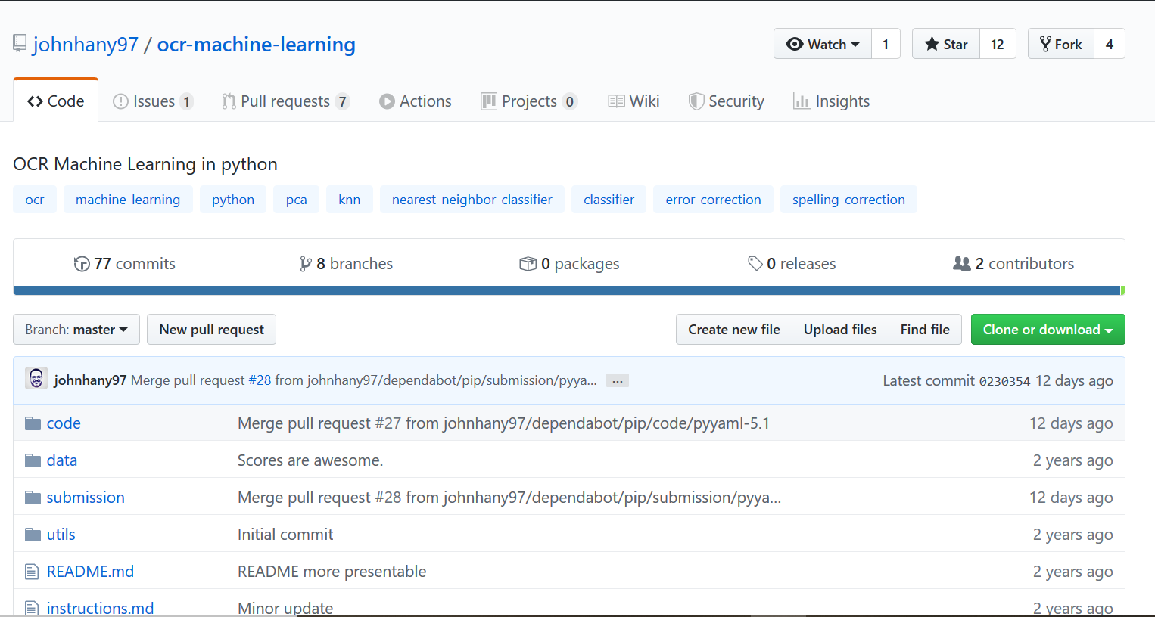
And the development continues…

Slide 16
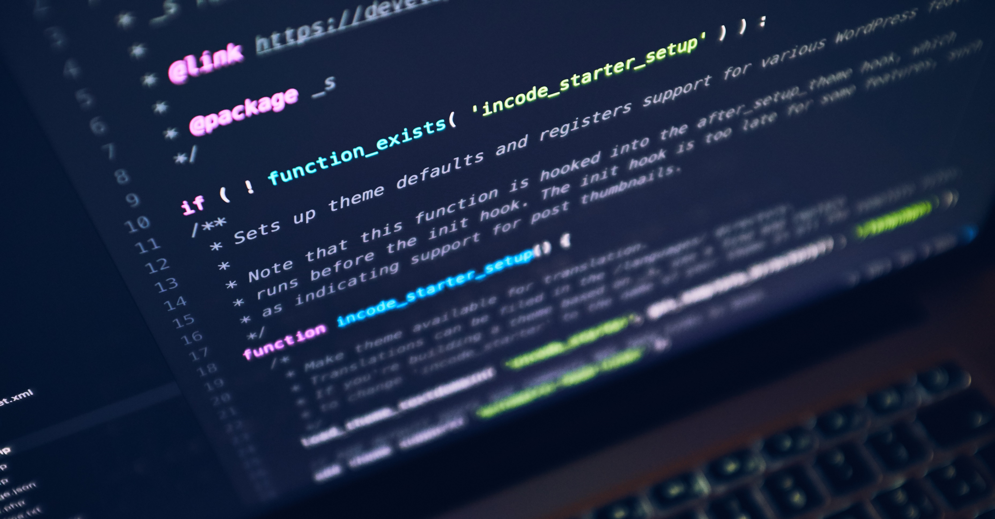
PROs and CONs of open-source OCR software:
PROs:
flexible integration of historical texts in different digital formats
adaptable to multiple languages and new fonts / page layouts
CONs:
takes up a lot of storage space
difficult installation
often limited performance on Windows and Mac)
usually requires command-line operation (no GUI)
conducting own training can be time-consuming
copyright issues if software provider requires you to ingest your (training) data into a public pool
Photo by Luca Bravo on Unsplash

Slide 17
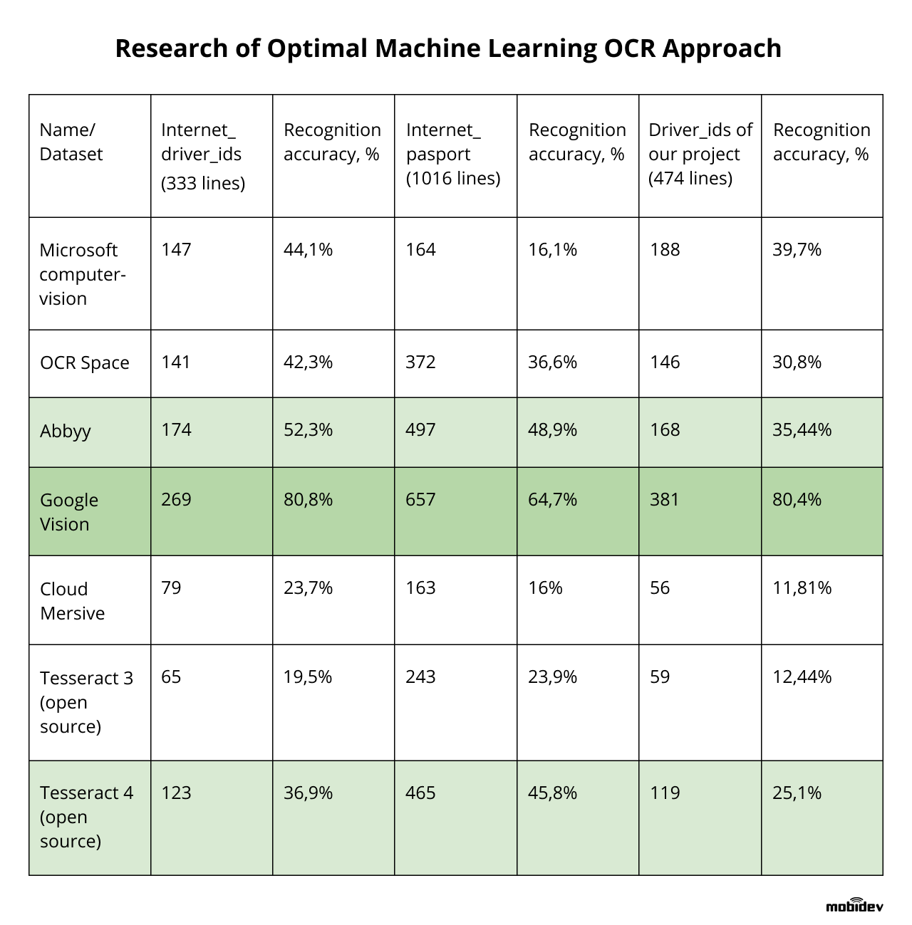
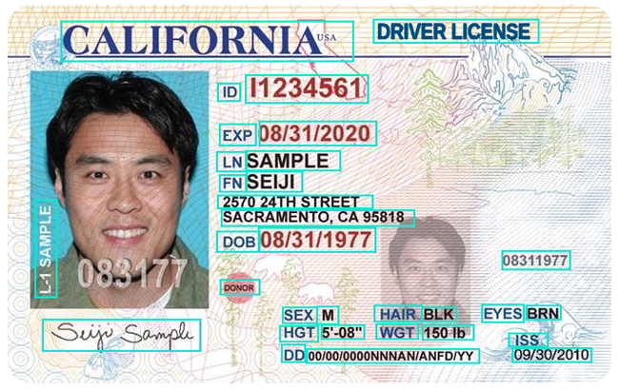
How reliable are current OCR tools?
Results based on an OCR test based on the US driver‘s licence, published on September 18, 2019:
https://mobidev.biz/blog/ocr-machine-learning-implementation

Slide 18







How can we integrate OCR into our own workflow?
Analyse non-coded plain text with topic modelling or stylometry tools not requiring structured data!
Original manuscript or print
Export scan as PDF or image files to perform OCR!
Export scan as PDF or image file to let humans extract metadata and transcribe the text!
Use transcriptions to train OCR-software and improve results for similar sources (e.g. issues of the same newspaper)!
Code information (e.g. in XML/TEI or JSON) and use software to analyse networks between specific tagged entities or visualise geographic data!
Perform quantitative analysis on more texts in less time and generate more reliable results!

Slide 19
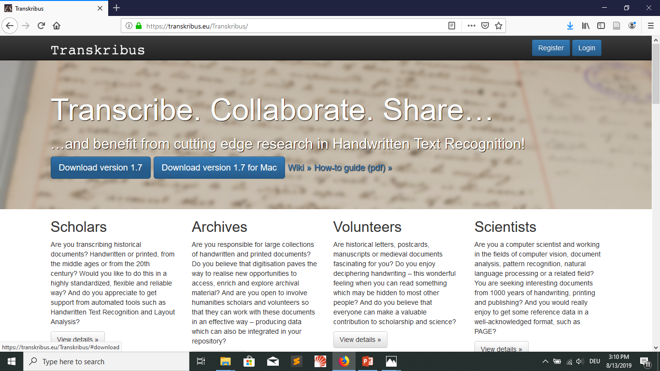
Testing a cloud-based OCR tool: transkribus.eu

